Slide 1




WE BELIEVE IN YOU

Slide 2





Kate Krzystolik
Zachary Hohl
Zachary Eaves
Iris Barreto

Slide 3
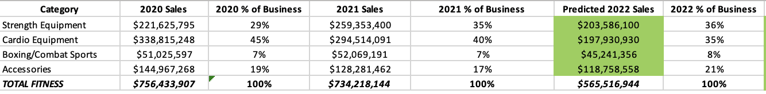

PREDICTED
FROM THIS
TOTAL*%
TO THIS
SALES TRENDS GROWTH FINDINGS
SALES DECLINE CHANNELS CARDIO FINDINGS

Slide 4
TRENDS OMNI
Millions
PREDICTED
36%
35%
TOTAL $566
21%
8%
TRENDS SALES DECLINE FINDINGS
SALES DECLINE CHANNELS CARDIO FINDINGS

Slide 5
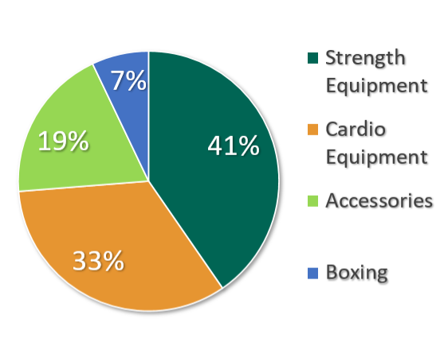


AVERAGE
TRENDS SALES DECLINE FINDINGS
SALES DECLINE CHANNELS CARDIO FINDINGS

Slide 6
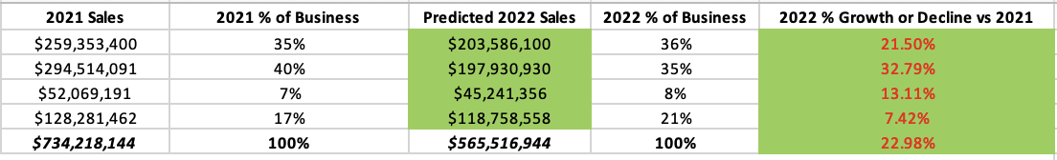
DECLINE
FROM THIS
Predicted - 2021
2021
TO THIS
TRENDS SALES DECLINE FINDINGS
SALES DECLINE CHANNELS CARDIO FINDINGS

Slide 7
DECLINE 2022-2021
Strength Equipment
Cardio Equipment
Boxing
Accessories
7%
13%
TOTAL 23%
21%
33%
SALES DECLINE CHANNELS CARDIO FINDINGS

Slide 8
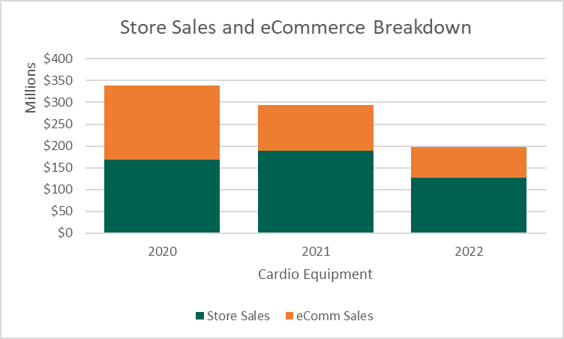
Cardio Equipment
73.8% of
Total Losses
SALES DECLINE CHANNELS CARDIO FINDINGS
Notes:
This contraction was felt heavily in our cardio equipment division. With approximately 140 million in Total overall losses. Its important to note the vast majority of these lost sales come eCommerce. There was a decrease of 90 million coming from store sales alone. Our store sales have held somewhat steady for some of our other departments, but cardio was clearly hit the hardest by the data. As stated before this segment lost the highest percentage and dollar amount of either of the other 3 segments, and as stated earlier represented a total percentage decrease of 32.8%

Slide 9
TOTAL SALES PER CHANNEL
2020
2021
2022
In-Store
$435,521,737
$519,559,541
$412,827,369
e-Commerce
$320,912,170
$214,658,603
$152,689,575
TRENDS SALES DECLINE FINDINGS
SALES DECLINE CHANNELS CARDIO FINDINGS
Notes:
In the past 2 years DICKS SPORTING GOODS has lost quite a bit of market share from its e-Commerce. A large amount of this is suspected to come from supply chain shortages and other factors impacting the value of the market entirely. While more people were ordering online, it was simultaneously getting harder for producers to handle the new demand and thus our total sales accrued fell sharply. Our in store total sales per channel is primarily what kept some of our segments heads above water, namely strength and boxing, making up for a huge portion of lost revenue in 2021. Our store sales have rebounded significantly over the past two years compared to e-commerce

Slide 10
STORE vs E-COMMERCE TOTAL
TRENDS SALES DECLINE FINDINGS
SALES DECLINE CHANNELS CARDIO FINDINGS

Slide 11
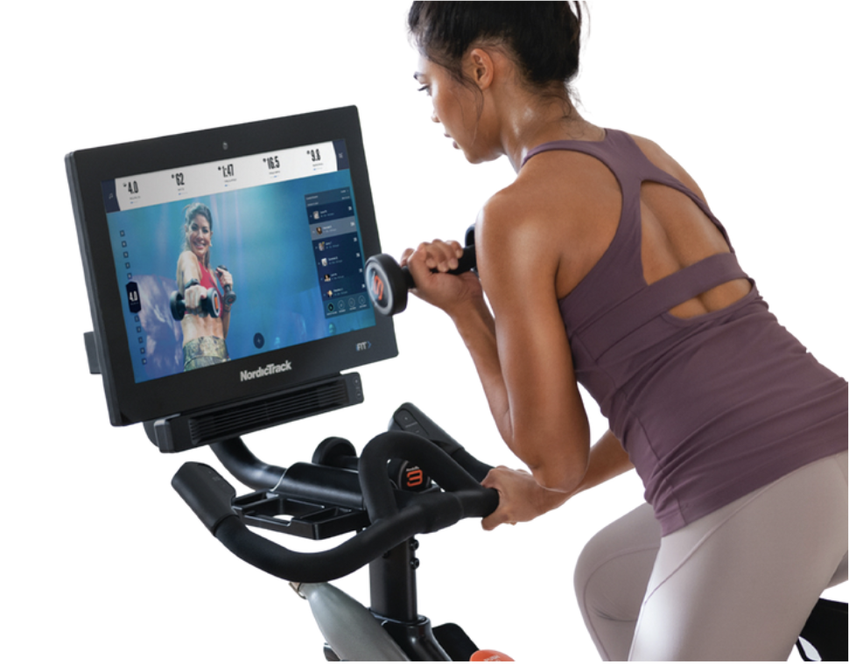
TOP FINDINGS
1
2
73.8% of Total Losses
47.58% Decrease
5.2% Decrease
In-Store Sales
23% decreased
Cardio Segment
Fitness Division
Online Shopping
3
4
SALES DECLINE CHANNELS CARDIO FINDINGS

